Slide 1
Hand gesture Detection and conversion to speech and text
Dhawal Sharma RA1911003010971
T. Saiprem RA1911003010974
Jatin arora ra1911003010976

Slide 2
The Problem
What is the problem?
It is very difficult for hearing-impaired people to communicate with the world.
Who has this problem?
Mute and deaf people.
Why should this problem be solved?
To provide a tool to aid the speech impaired by retrie

Slide 3
Abstract
The hand gestures are one of the typical methods used in sign language. It is very difficult for the hearing impaired people to communicate with the world. This project presents a solution that will not only automatically recognize the hand gestures but will also convert it into speech and text output so that impaired person can easily communicate with normal people

Slide 4
Workable Solutions
REQUIREMENTS
Data set
Solution #2
Solution #3
What materials does this solution require?
What would this solution look like (drawing, pictures, text)?
What are some barriers you might come across with this solution?
Open CV
Play sound
Numpy
Tensor flow

Slide 5
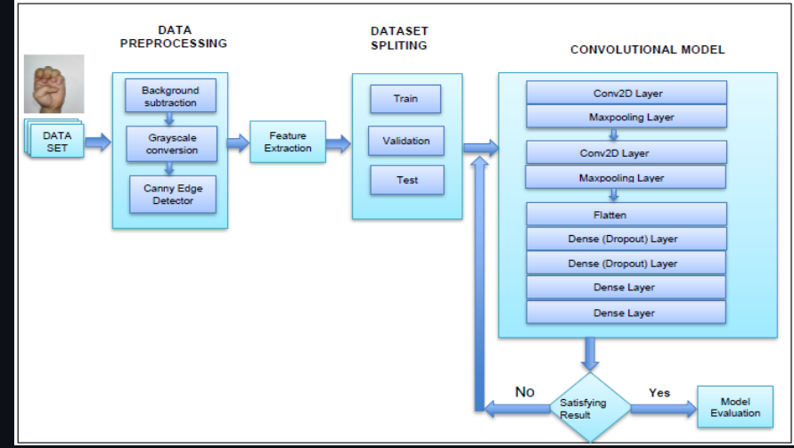
System architecture

Slide 6
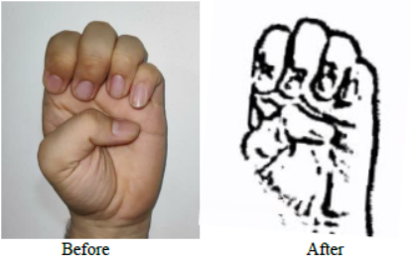
Testing

Slide 7
Future scope
The application can be integrated with other mobile and IoT devices to improve user interaction and make the system more robust. The accuracy of the program can be further improvised by using neural networks.
An alternate stress could be put on the use of the application in the fields of medicines, military, governance etc.
Finally, the use can be further designed to make more accessible to the consumers. The whole point of making the solution as a commercially viable product for the users is to help the impaired community around the world.

Slide 8
conclusion
The practical adaption of the interface solution for visually impaired and blind people is limited by simplicity and usability in practical scenarios. As an easy and practical way to achieve human-computer- interaction, in this solution hand gesture to speech and text conversion has been used to facilitate the reduction of hardware components.
The solution aims to provide aid to those in need thus ensuring social relevance. The people can easily communicate with each other.

